Slide 1

A Visual Analysis of 1000 Passenger Reviews
By Mark Coty
https://github.com/markcoty/markcoty

Slide 2
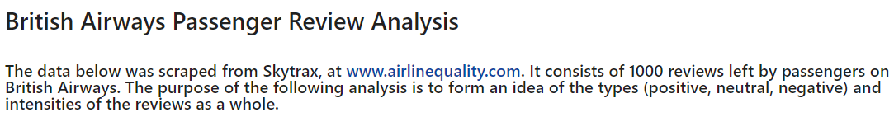
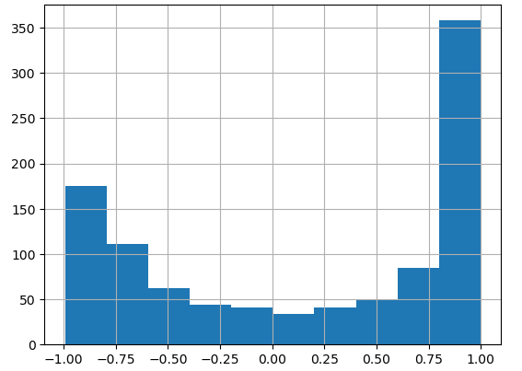
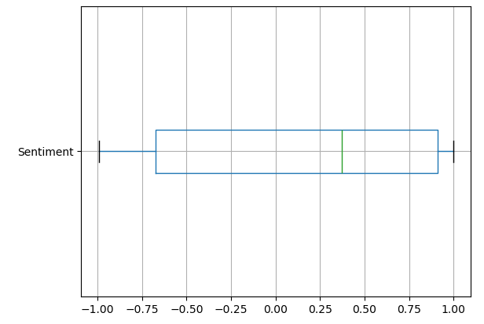
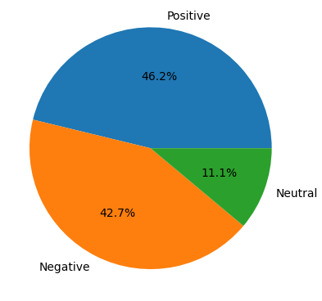
From the pie chart below, we can see that positive and negative reviews predominate, which is to be expected.
Sentiment measures the intensity of the passenger’s review, ranging from -1 (strongly negative) to 1 (strongly positive).

